Slide 1


Global Healthcare Data ETL & Analysis CLI
A Data Pipeline Project using Python & MySQL
Trainer : Nikhil Sharma
Presented by: Muthumaran T

Slide 2


Objective
The objective of this project is to develop a robust data pipeline and an intuitive dashboard. It will extract and transform global COVID-19 and vaccination data from a public API, store it in a MySQL database, and then visualize it through a Streamlit-powered dashboard, enabling real-time, filterable insights for comprehensive analysis.
The objective of this project is to develop a robust data pipeline and an intuitive dashboard. It will extract and transform global COVID-19 and vaccination data from a public API, store it in a MySQL database, and then visualize it through a Streamlit-powered dashboard, enabling real-time, filterable insights for comprehensive analysis.

Slide 3


Data Source Details
COVID-19 Case Data
Vaccination Data
Sourced from the WHO COVID-19 Vaccination Database, which tracks administered vaccine doses, fully vaccinated populations, and vaccination rates globally. This API ensures granular insights into global immunization efforts.
Fetched from the Our World in Data COVID-19 API, providing daily updates on confirmed cases, deaths, and recoveries for all countries and regions. Data includes cumulative and new daily figures.

Slide 4
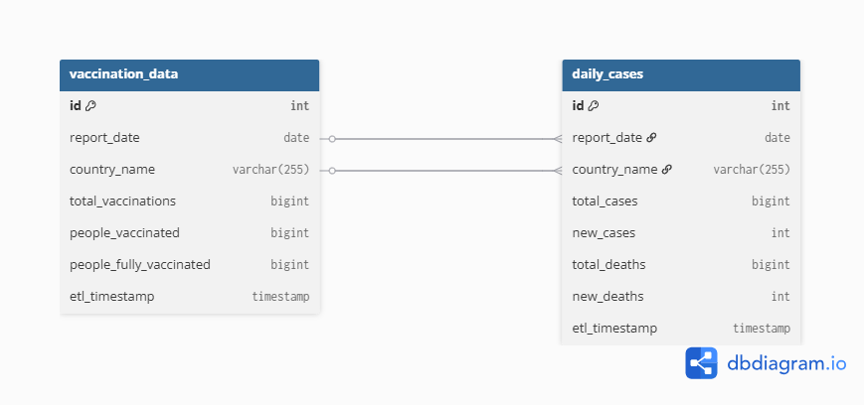
TABLES & Relationship

Slide 5
ETL Pipeline
Extract
Transform
Load
Utilize requests library to pull raw COVID-19 data from external APIs, ensuring timely updates.
Process raw data using Pandas for cleaning, normalization, and structuring into tables .
Load refined data into MySQL via mysql-connector-python, ensuring data integrity and accessibility.

Slide 6
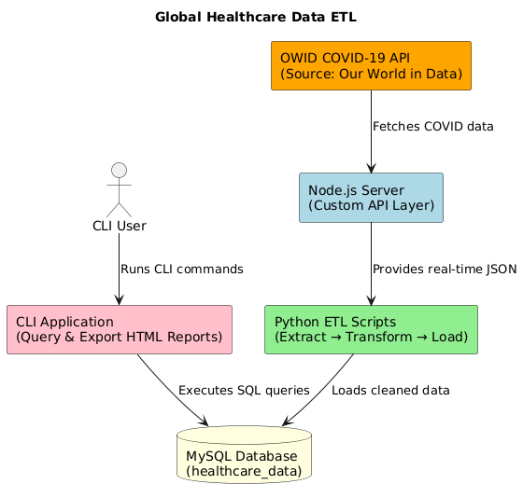
Architecture
Data is extracted from the OWID API via a custom Node.js server.
Python ETL scripts clean, transform, and load the data into a MySQL database.
A CLI tool enables users to query data and generate HTML reports easily.

Slide 7
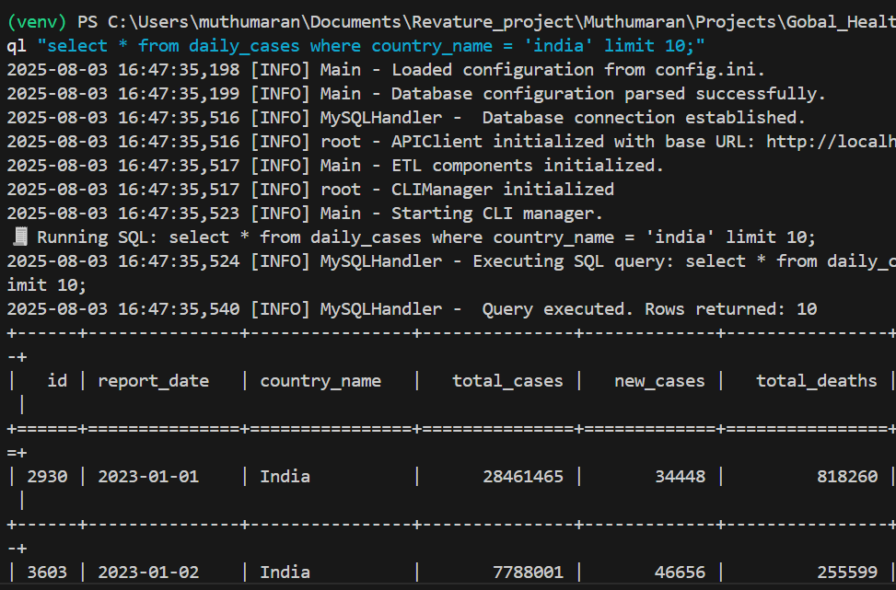

Command-Line Interface
Fetch new data: python main.py --fetch
Query metrics: python main.py --query cases --country USA
List available tables: python main.py --list-tables
Drop specific table: python main.py --drop-table daily_cases
Export data to CSV: python main.py --export vaccinations.csv
The CLI, built with argparse, provides robust control for data engineers and analysts, enabling direct interaction with the database for operations, queries, and exports.

Slide 8
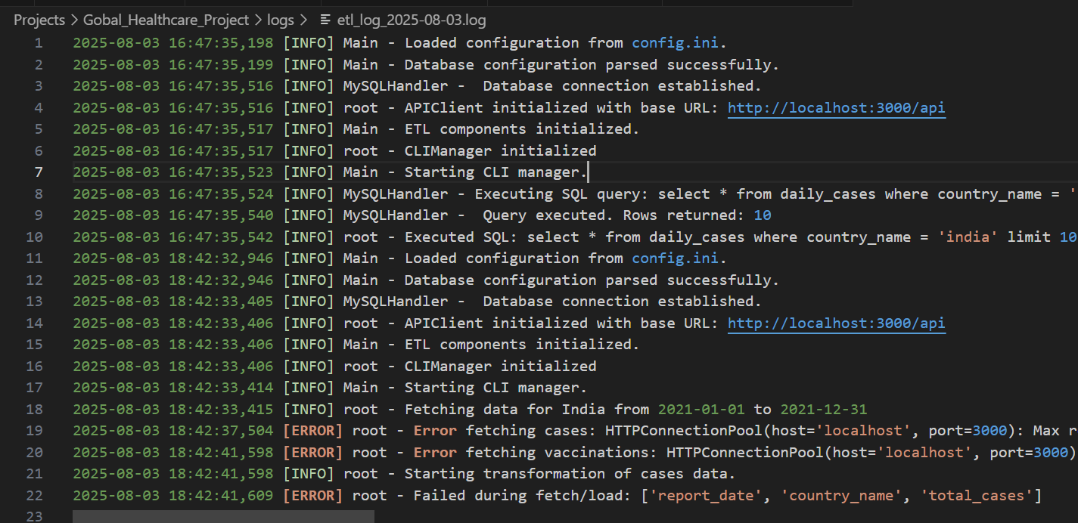
Log Files

Slide 9
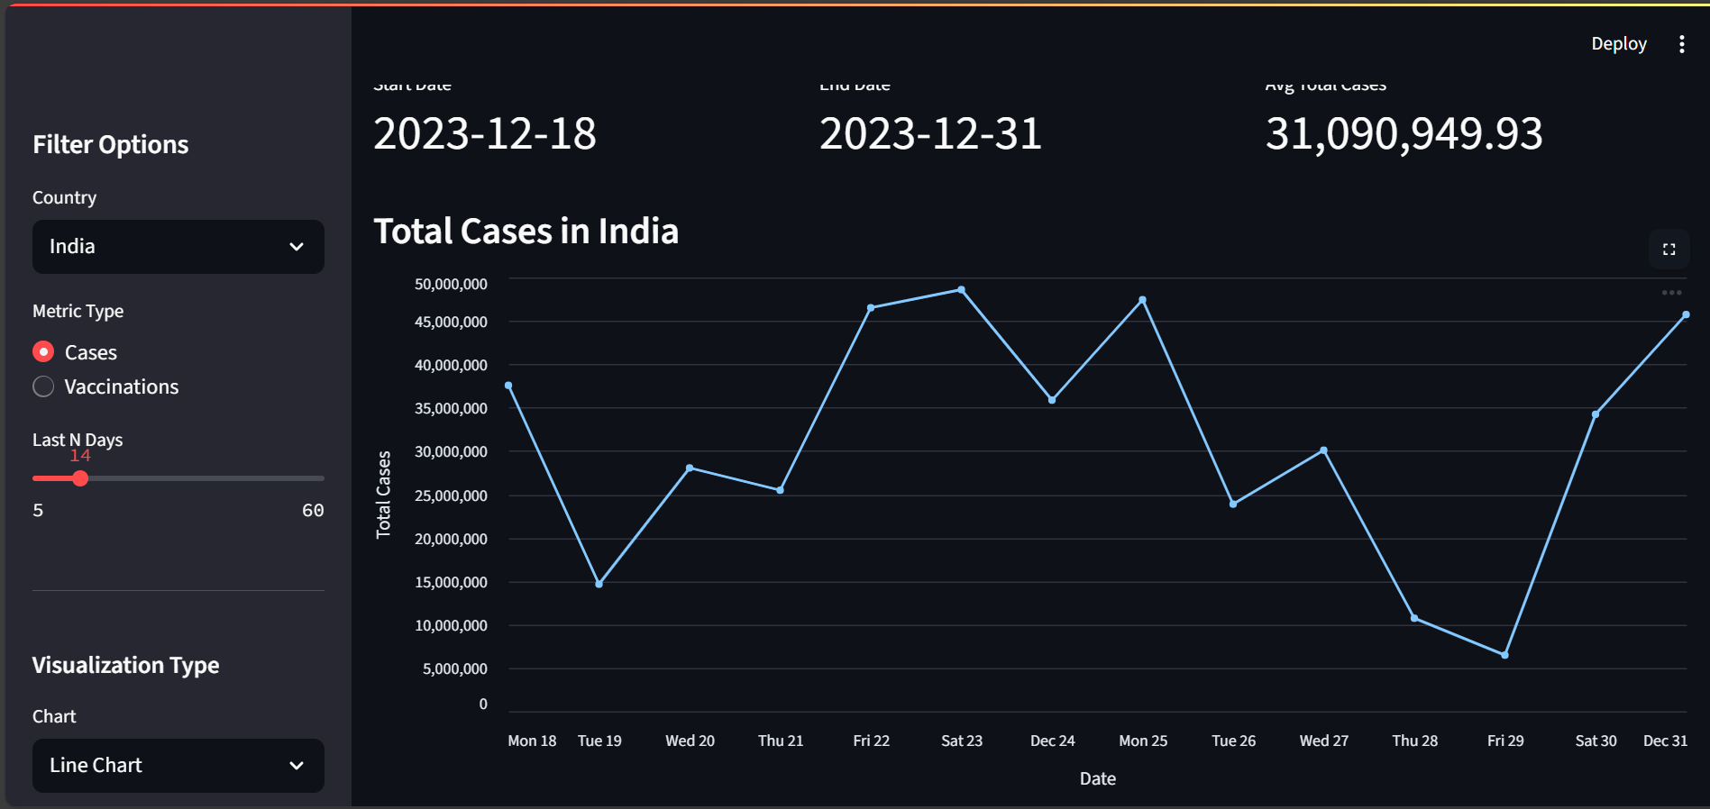
Streamlit Dashboard
Dynamic Filters
Filter by country, metric type (cases, deaths, vaccinations)
Analyze data for custom timeframes (e.g., last N days)
Visual Exploration
Line charts for trend analysis
Bar charts for comparative views
Utility Features
Download filtered data as CSV
Raw data explorer for detailed review

Slide 10
Dashboard

Slide 11
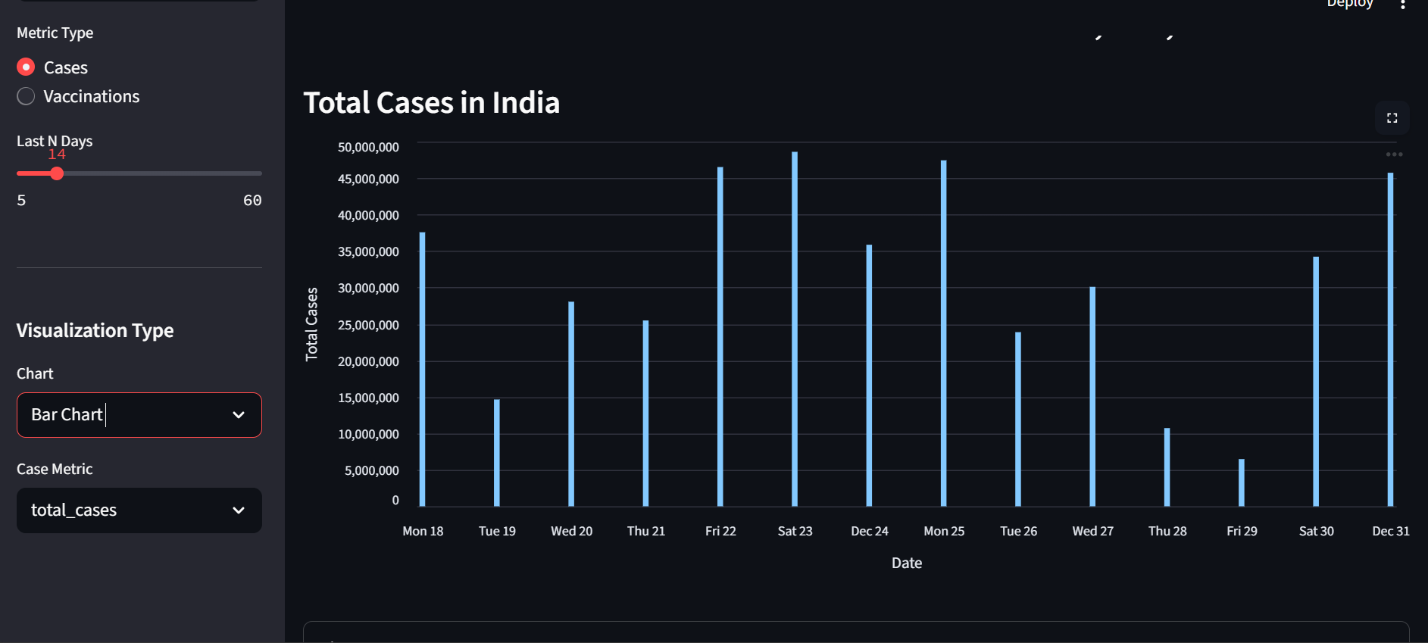
Dashboard

Slide 12


Thank you

